Slide 1
EE 521/ECE 582 – Analysis of Power systems
Class #7 – September 15, 2022
Dr. Noel N. Schulz
Edmund O. Schweitzer III Chair in
Power Apparatus and Systems
Chief Scientist Joint Appointment, PNNL
Co-Director, PNNL/WSU Advanced Grid Institute (AGI)
Washington State University Pullman
Noel.Schulz@wsu.edu EME 35
509-335-0980 (o) and 509-336-5522 (c)

Slide 2
Student Hours
Pullman this week
Tuesdays 4:30-5:30 pm (after class)
Wednesdays 4-5 pm
Fridays 1:30-2:30 pm
Join from PC, Mac, Linux, iOS, or Android: https://wsu.zoom.us/j/8237216735 (Links to an external site.)
Meeting ID: 823 721 6735
Or by request via email noel.Schulz@wsu.edu or phone 509-336-5522

Slide 3
Check In Meetings
Today, Friday and Wednesday
Need more times for those who didn’t sign up by yesterday. Will email you!
Checking your work – Example on Page 90 of textbook and example in notes
14 Bus Cases
Do not use Tap values for first part of work (will discuss next week)
Do a few Y bus calculations by hand and compare to your program (including Y99)
Will post information from check-in meetings in discussions on Canvas

Slide 4
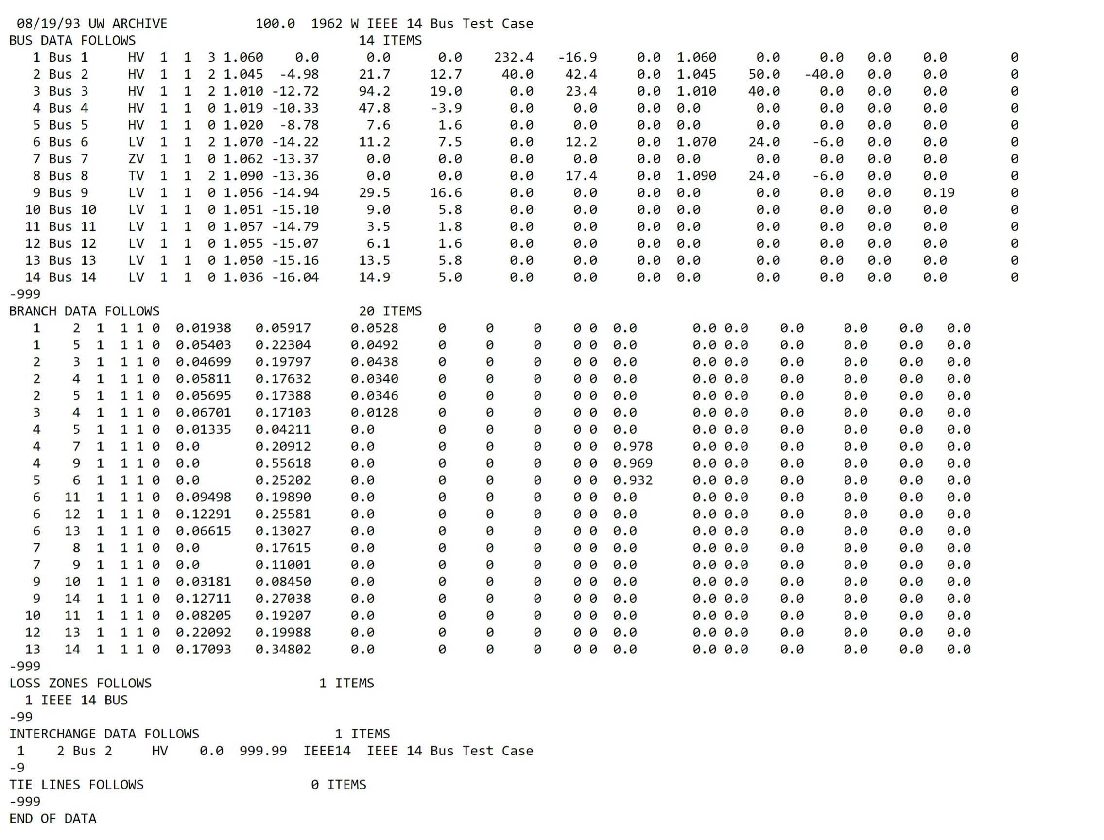
Check In Meetings – part 2

Slide 5
Programming Projects:
Power Flow Project (20%)
Y_{bus}, Jacobian matrices – Newton Raphson
LU Factorization, Backward-Forward substitution for NR
Fast Decoupled
Q-limits, transformer taps

Slide 6
Answering Questions
Multiplications for full matrix - 2(n+1)!
Matrix Size | Calculations | Time (1 ms) | Time (1 uS)
2 | 12 | 0.012 | 0.000012
3 | 48 | 0.048 | 0.000048
4 | 240 | 0.24 | 0.00024
5 | 1440 | 1.44 | 0.00144
6 | 10080 | 10.08 | 0.01008
7 | 80640 | 80.64 | 0.08064
8 | 725760 | 725.76 | 0.72576
9 | 7257600 | 7257.6 | 7.2576
10 | 79833600 | 79833.6 | 79.8336
100 | 1.89E+160 | 1.8852E+157 | 1.8852E+154

Slide 7
Why do we care about the other methods we are discussing in the book?

Slide 8
To Chapter 3
The generalization of linear systems is nonlinear systems:
where:
Each f(x) may not necessarily contain all states
Even in only one equation is nonlinear, the whole system is considered to be nonlinear
Cannot usually be solved analytically for x
Must be solved iteratively

Slide 9
Fixed point iteration
A fixed point iteration is an iteration that recasts f(x) = 0 as x = g(x)
Consider:
The solutions to this equation are x = 1 and x = 4

Slide 10
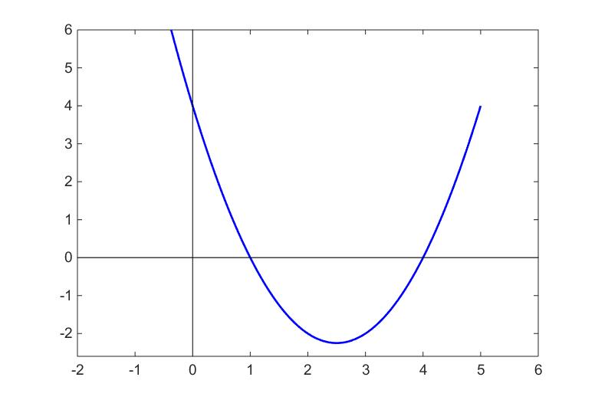
solutions

Slide 11
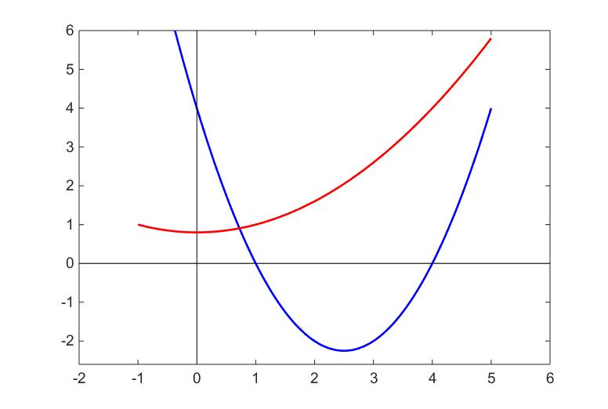
Recast f(x) = 0 as g(x) = x
Solutions of g(x) = x are same as f(x) =0

Slide 12
Start with x⁰ = 3
etc

Slide 13
What happens if we start with x⁰ = 5?
?
Diverging

Slide 14
Region of Convergence
S₀
x∗
x⁰
S
A point x∗ is said to be a point of attraction of an iterative
function if there exists an open neighborhood S₀ of x∗ such that for all
initial guesses x⁰ in the subset S₀ of S, the iterates will remain in S and
The neighborhood S₀ is called the domain of attraction of x∗

Slide 15
Types of convergence
Monotonic Convergence
Oscillating Convergence
Monotonic Divergence
Oscillating Divergence

Slide 16
Newton Raphson
Consider again: with the solution x*
Expand f(x) in a Taylor Series Expansion about :
higher order terms ≈ 0
If is sufficiently close to x*, then is small for large powers and can be neglected. These are also known as higher order terms.

Slide 17
Substitute x^{k+1} for x* and x^{k} for and solve for x^{k+1} :
Newton Raphson Iteration
Note that is the slope of f(x)

Slide 18
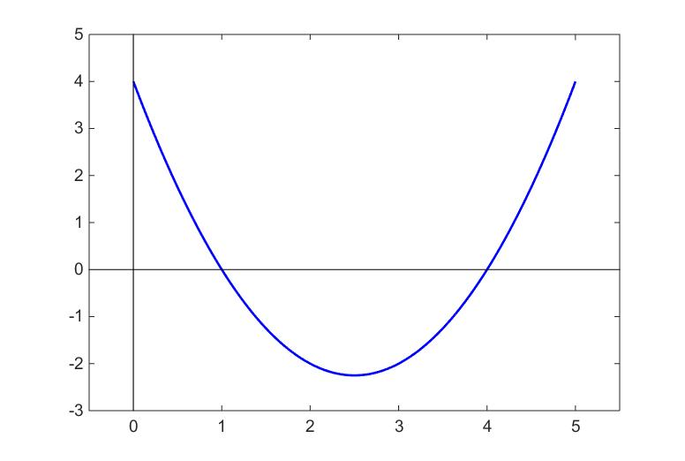
Newton Raphson Iteration

Slide 19
slope
slope
Much faster convergence!
slope

Slide 20
Possible convergence problems
No real root (i.e. f(x) doesn’t cross 0 axis)
Second derivative f’’(x)= 0
Initial guess not in region of convergence

Slide 21
Newton-Raphson for systems of nonlinear equations:
Jacobian of f(x)

Slide 22
Jacobian matrix
Jacobian of f(x)
Set of equations
n x n matrix of partial derivatives

Slide 23
Example:
Solve
Let ε = 10⁻³ and
Set up NR equations:

Slide 24
Start with

Slide 25
Note that the equations
Can be rewritten as:
which is in the form:
and should be solved using one of the linear solvers. Do not invert the Jacobian matrix!

Slide 26
Solving for x:
How do we determine convergence?
Recall that we want f(x) → 0, so we should check whether or not
Repeating:
We have not yet converged, so repeat.

Slide 27
Less than 0.001, so NR method has converged to the solution
Calculating f(x³) yields:

Slide 28
Errors
Once the iterate values are sufficiently close to the solution, the error decreases rapidly.
In fact, the error decreases as the square of the previous error:
error(k+1) ≈ (error(k))²
This is known as quadratic convergence.

Slide 29
Quasi-Newton Methods
The calculation of n² partial derivatives in the Jacobian can be computationally expensive, therefore it is advantageous to explore methods to reduce this burden.
Full Newton-Raphson Iteration
A method that uses a (hopefully) computationally efficient matrix M is a Quasi-Newton Method

Slide 30
Secant Method
Recall that the NR method uses the slope of the function to update the subsequent iteration.
(x⁰, f(x⁰))
slope
The secant method estimates the slope of the tangent by taking two points
close to the desired root and interpolates between them
slope
(x¹, f(x¹))
slope
The primary drawback with this method is that it requires both x⁰ and x¹ to start the iterations.

Slide 31
The Secant method can often be faster than the Newton-Raphson method even though more iterations are often required for convergence.
Solve starting with x⁰ = 1.5 and x¹ = 1.4
The Secant method is a wise choice in this case since finding the partial of f(x) may be problematic (depending on how well you remember your calculus).

Slide 32
Broyden’s Method
The Secant method only works for systems of a single variable. The Broyden’s method is the generalization of the method to a system of n equations in n unknowns.
Consider again
Let
where
and

Slide 33
Example:
Solve
Let ε = 10⁻³ and
To initialize the Broyden’s method, we also need an initial guess for M₀.
Using the initial Jacobian as M₀ and the initial function f(x⁰):

Slide 34
error > 0.001, repeat

Slide 35
error > 0.001, repeat

Slide 36
Announcements
Finish Reading Chapter 3
Extra Video will drop Friday
MATLAB Program
Input the CDF file – Start with Data in Program
Start working on building the Ybus
Calculate Jacobian Matrix Values
Work on LU Decomposition and Solution
See example on Page 90 to check your work

Slide 37
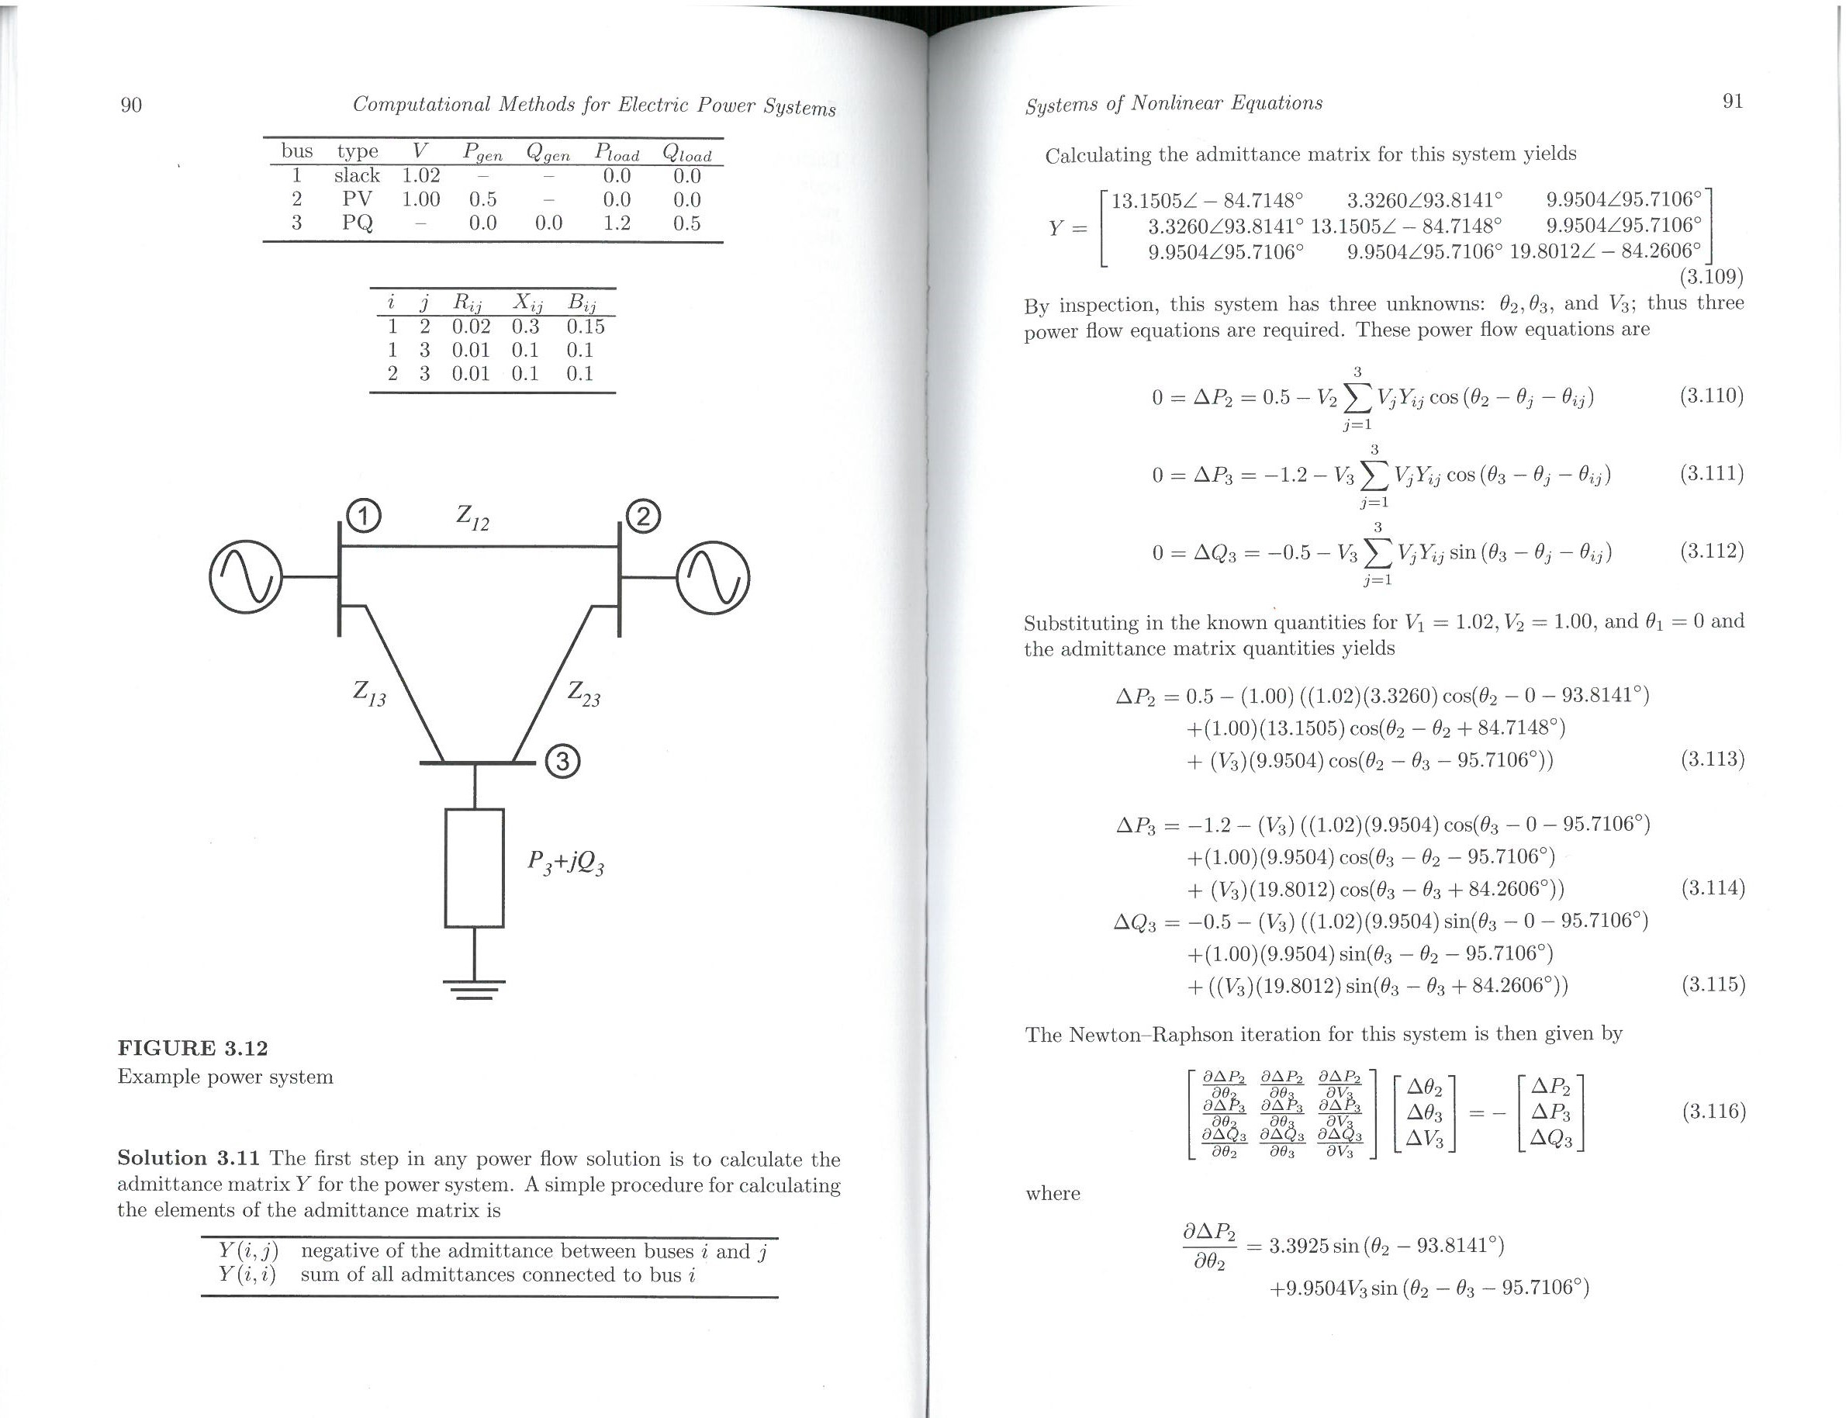

Slide 38
